Slide 1
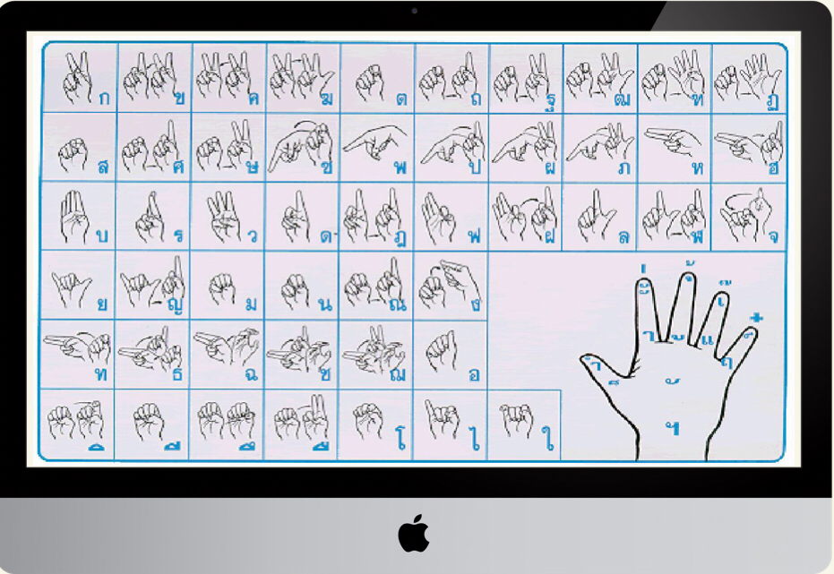
Thai Sign Language Recognition
Members List:
Krit Chayaniyayodhin 60130500207
Jullapol Satienpisarn 60130500208
Natkjorn Trakusangpaisarn 60130500210
Nipat Phattarakijtham 60130500216
Kittichok Techayanyong 60130500241

Slide 2
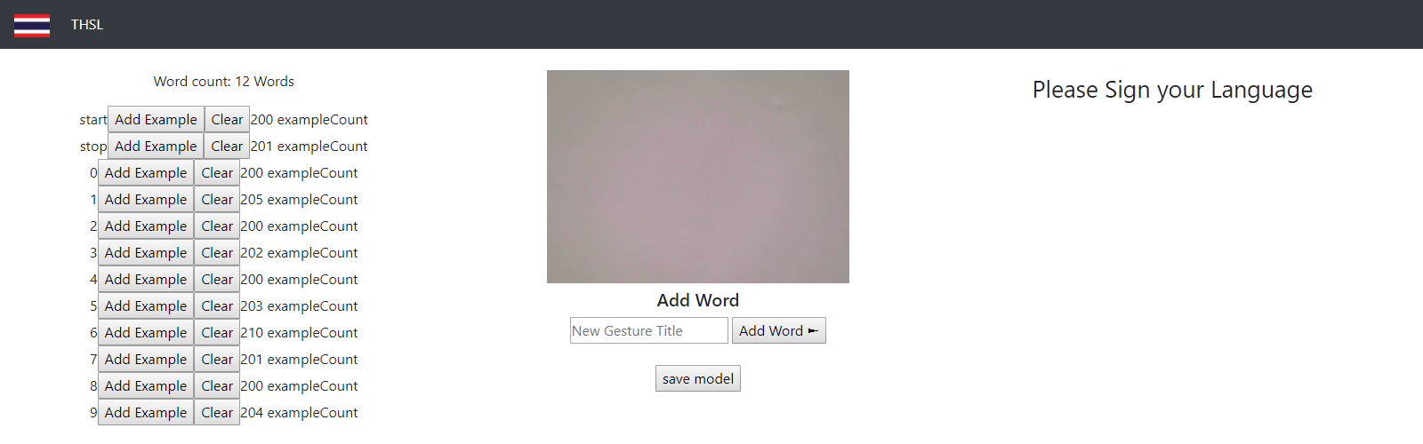
WHAT IS OUR SYSTEM?
Web based application for real-time Thai sign language recognition

Slide 3
FEATURES
Real time image recognition
Word concatenation
Live training (adding examples to model)
Text to speech
Save model

Slide 4
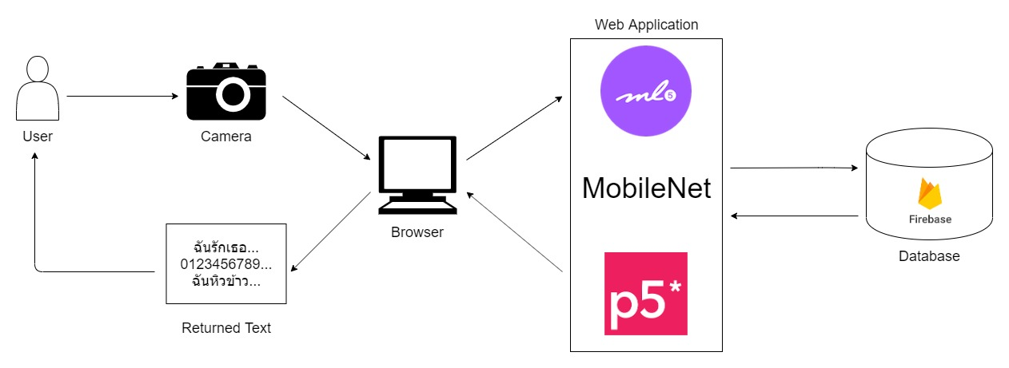
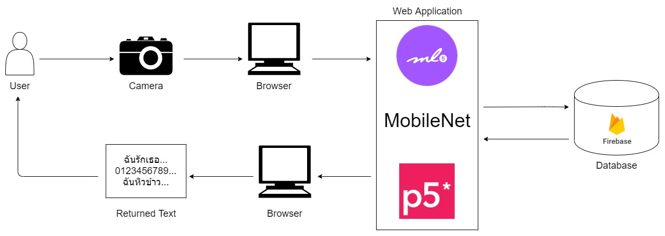
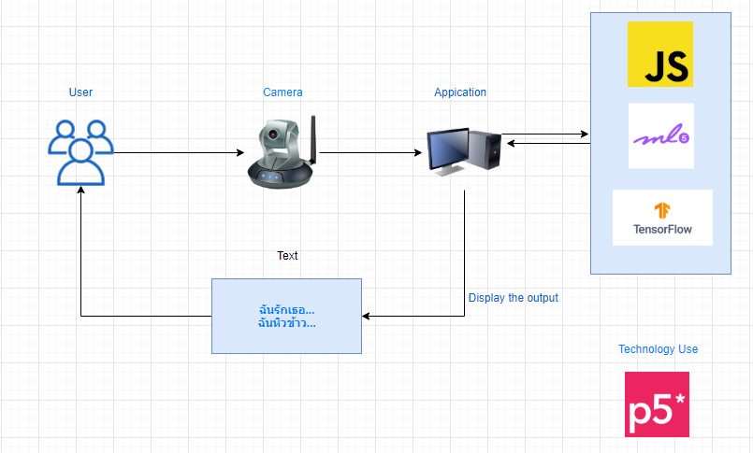
System Architecture Diagram

Slide 5
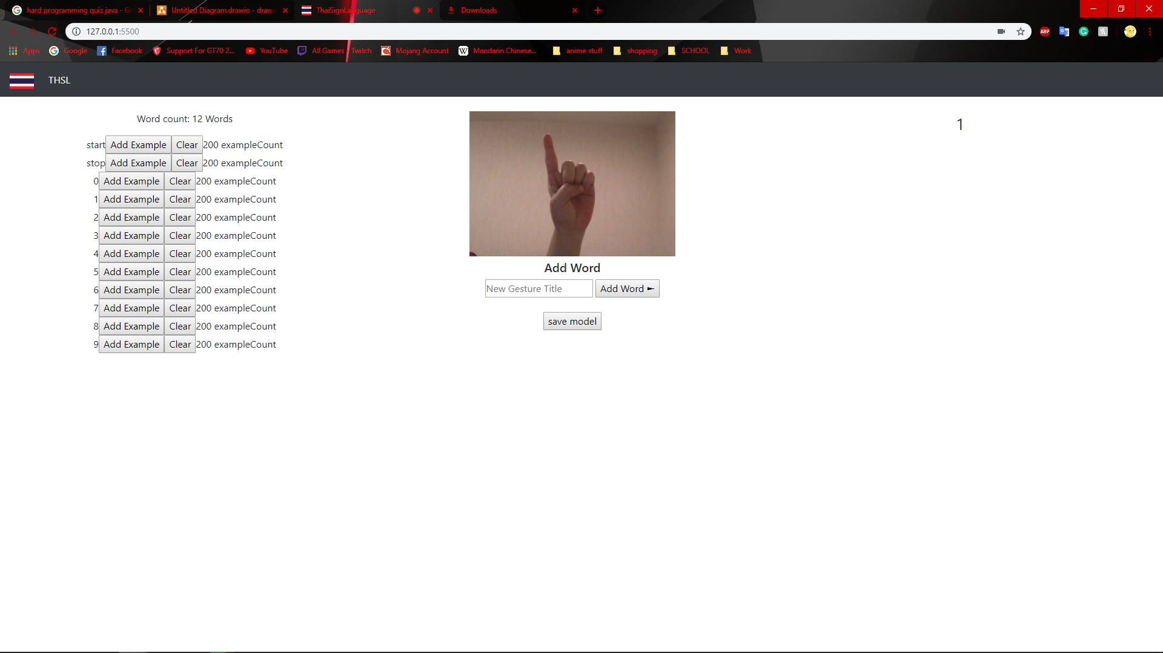
PROJECT GUI (Overview)

Slide 6
PROJECT GUI (Training)
Camera
Words available
for detecting and training
Add word for Training
Add Example into KNN-classifier

Slide 7
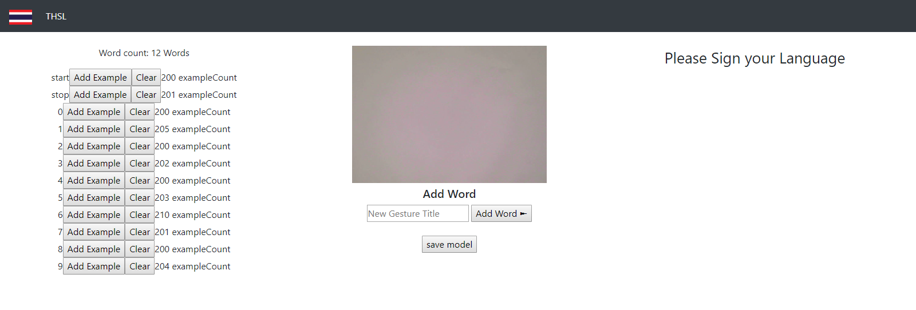
PROJECT GUI (Classifying)
Webcam sends image to classifier
Keeps classified text that have over 90% confidence

Slide 8
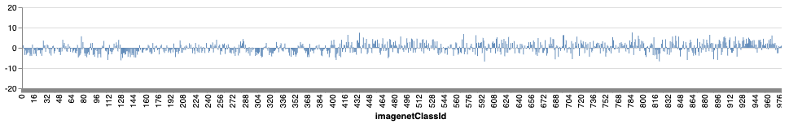
COMPONENT DETAIL
The system uses a KNN-Classifier provided by ml5 (tensorflow.js library)
Training image and the prediction image are preprocessed by mobilenet’s infer function to extract features from the image such that 1000 dims of unnormalized logits are form.

Slide 9
COMPONENT DETAIL (cont.)
The number of nearest neighbor nodes is 10
The result of the classifier is an array of confidences
The system will only display the classified value if the confidence is greater than 90%
A start signal is needed before result is shown

Slide 10
Future Suggestions
Use a neural network model to improve accuracy
GUI for training should be separate from recognizing
Camera window should be bigger for user experience
Should show current predictions confidence
Training should have a window that displays trained images
Train the model offline then load the model to predict
Increase the size of dataset

Slide 11
Reference & More Information
Is Sign Language International?. (2019).
Retrieved from http://www.signwriting.org/about/
questions/quest0001.html
kapook.com. (2019). ภาษามือเบื้องต้น 20 ท่า สำหรับใช้ในชีวิตประจำว Retrieved from https://hilight.kapook.com/view/85839 Making Amazon Alexa respond to Sign Language using AI. (2019). Retrieved from https://www.youtube.com/watch?v=
kS53y6GWm0w ml5.js: Transfer Learning with Feature Extractor. (2018). Retrieved from https://www.youtube.com/watch?v=
kRpZ5OqUY6Y

